Slide 1
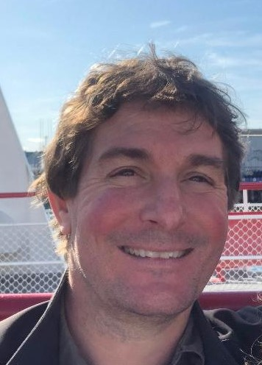
Joe Ivanic
Computational Scientist, Advanced Biomedical Computational Science
My Experience
30+ years experience in Quantum Chemistry
Developed many high-level theories/methods
Used quantum chemistry for health research
Worked at DoE, DoD, & NCI/NIH
Education
BS, Mathematics/Chemistry, University of Melbourne
PhD, Quantum Chemistry, University of Melbourne
About Me
I grew up in the remote Australian Outback
I like running/sports, cooking, crosswords, coffee
I’ve played guitar for 40+ years (rock & classical)

Slide 2
Seminar #3 by Dr. Susan Mertins
Date - Thu July 7, 2022, 2:00 pm – 3:00 pm ET
Meeting Link - https://teams.microsoft.com/l/meetup-join/19%3ameeting_MjQ5YjgxNGEtYjEwNC00ZGQ4LThlZDYtYWM1ZTA4NmYzZjlm%40thread.v2/0?context=%7b%22Tid%22%3a%2214b77578-9773-42d5-8507-251ca2dc2b06%22%2c%22Oid%22%3a%222e31b4fb-2c54-4995-be48-173a24bc5b84%22%7d
TITLE - Modeling Dynamic Cellular Reaction Networks: Applications to drug discovery and development
PRESENTER – Dr. Susan D. Mertins, Ph.D. Senior Investigator, FNLCR
ABSTRACT - In this seminar, an introduction to modeling reaction networks computationally will be addressed. Current efforts capitalize on GUIs that allow biologists with little mathematical background to create depictions of important signal transduction pathways. Further, this type of modeling, accomplished with ordinary differential equations (ODEs), is particularly useful in drug discovery and development. Mechanistic modeling of drug mechanism of action could predict therapeutic output and the same models could allow identification of biomarkers. The MAPK pathway will be introduced, simulations presented, and future modeling efforts discussed.

